Slide 1

Econland Game
By Group 31:
Ilya Gerasimenko
Gataullina Diana Timur Arutyunyan
Victoria Bormashova
30 May 2021
Bychkov Arthur
Ladus Yaroslava Starodubtseva Sofia
Moscow, 2021

Slide 2

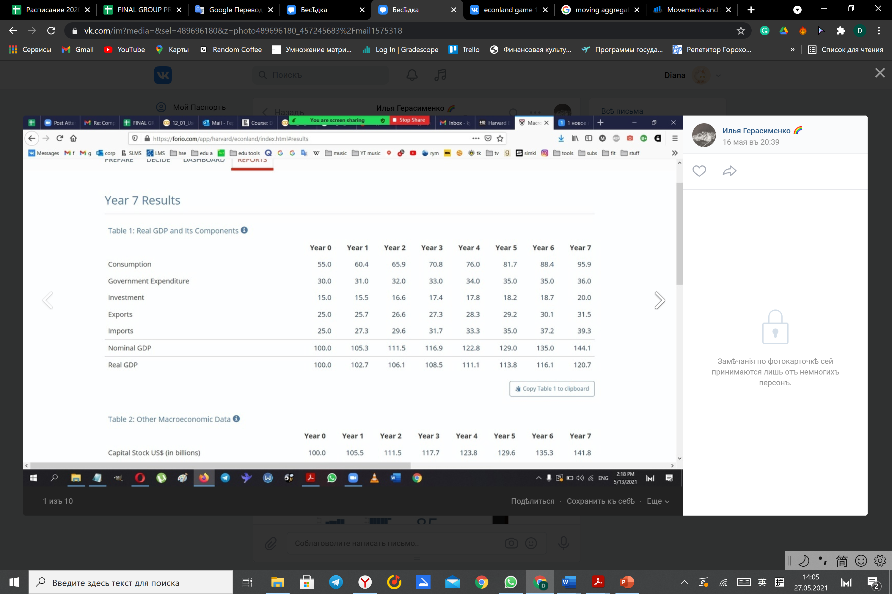
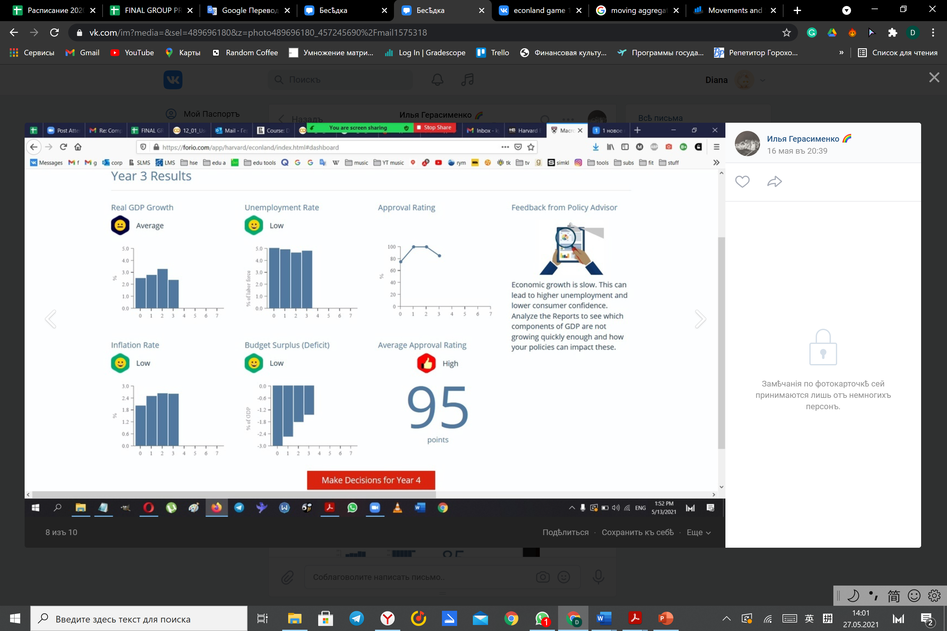
GAME 1
The main principles we used:
operating slowly and over time.
increasing our government expenditures every year by 1 billion, if possible.
keeping our budget in surplus, that is, below the 3% deficit threshold.

Slide 3



LRAS SRAS
As government expenditures directly account for a part of GDP, by increasing it, we can move the aggregate demand al little to the right each year
P
AD1 AD2

Slide 4
Changes: changing interest rate from 3 to 2.5% the 1 billion increase in government spending Expectation: moving the aggregate demand to the right and increasing real GDP growth. Result: an increase in GDP growth and inflation, and a slight decrease in unemployment and budget surplus (as expected)
THE YEAR 1

Slide 5
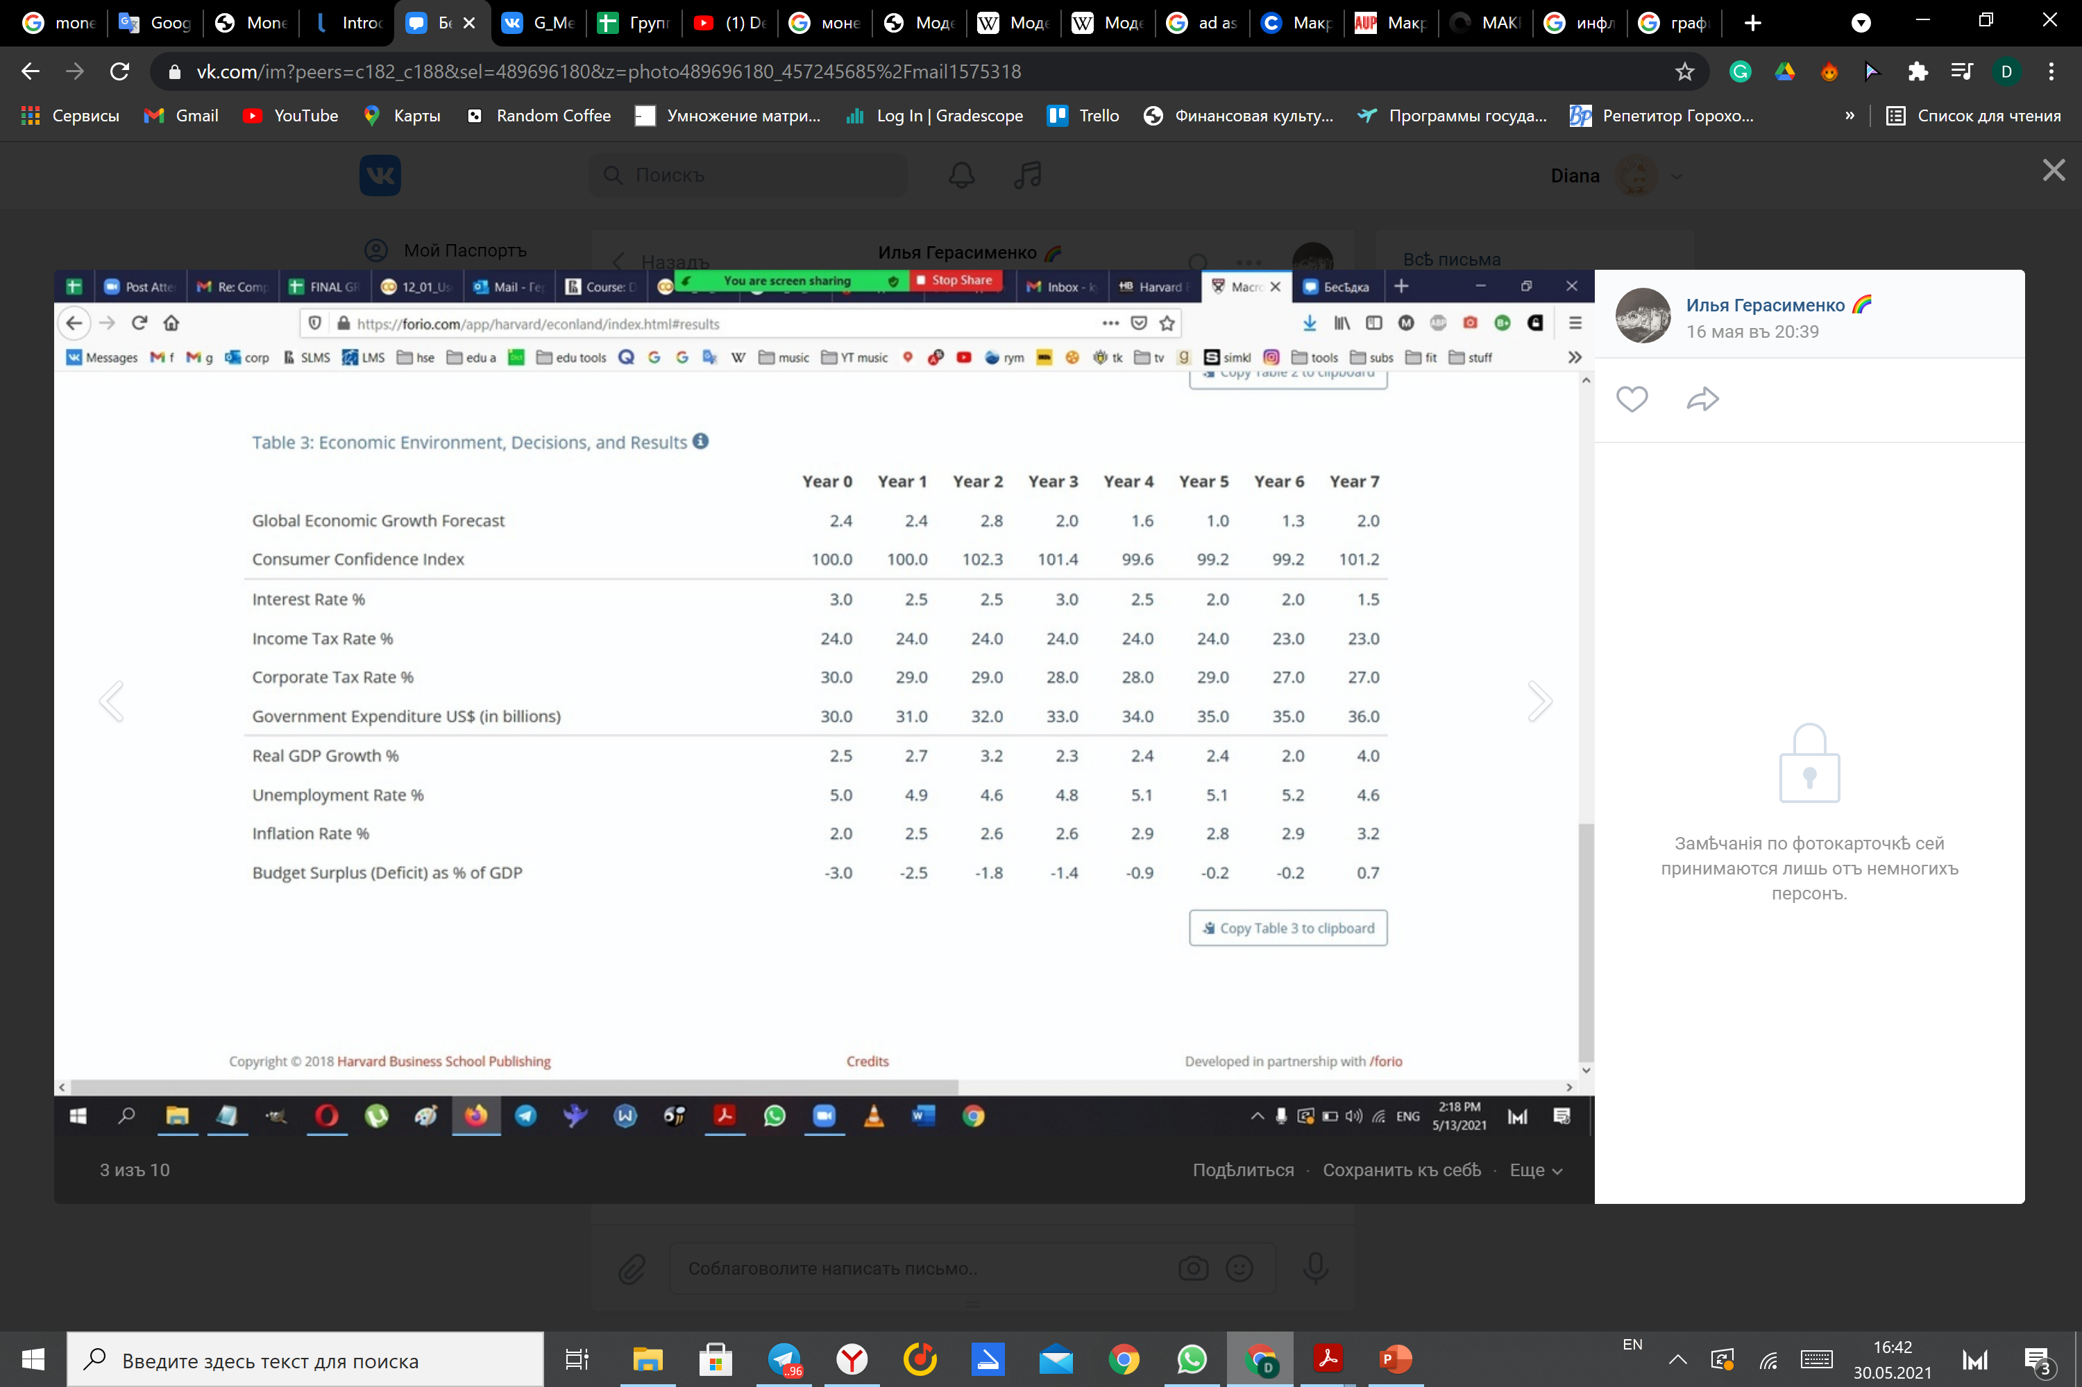


THE YEAR 1
P
Increasing GE -> AD shifts to the right
Decreasing Interest Rate -> AD shifts to the right
AD1 AD2
AD
Y

Slide 6
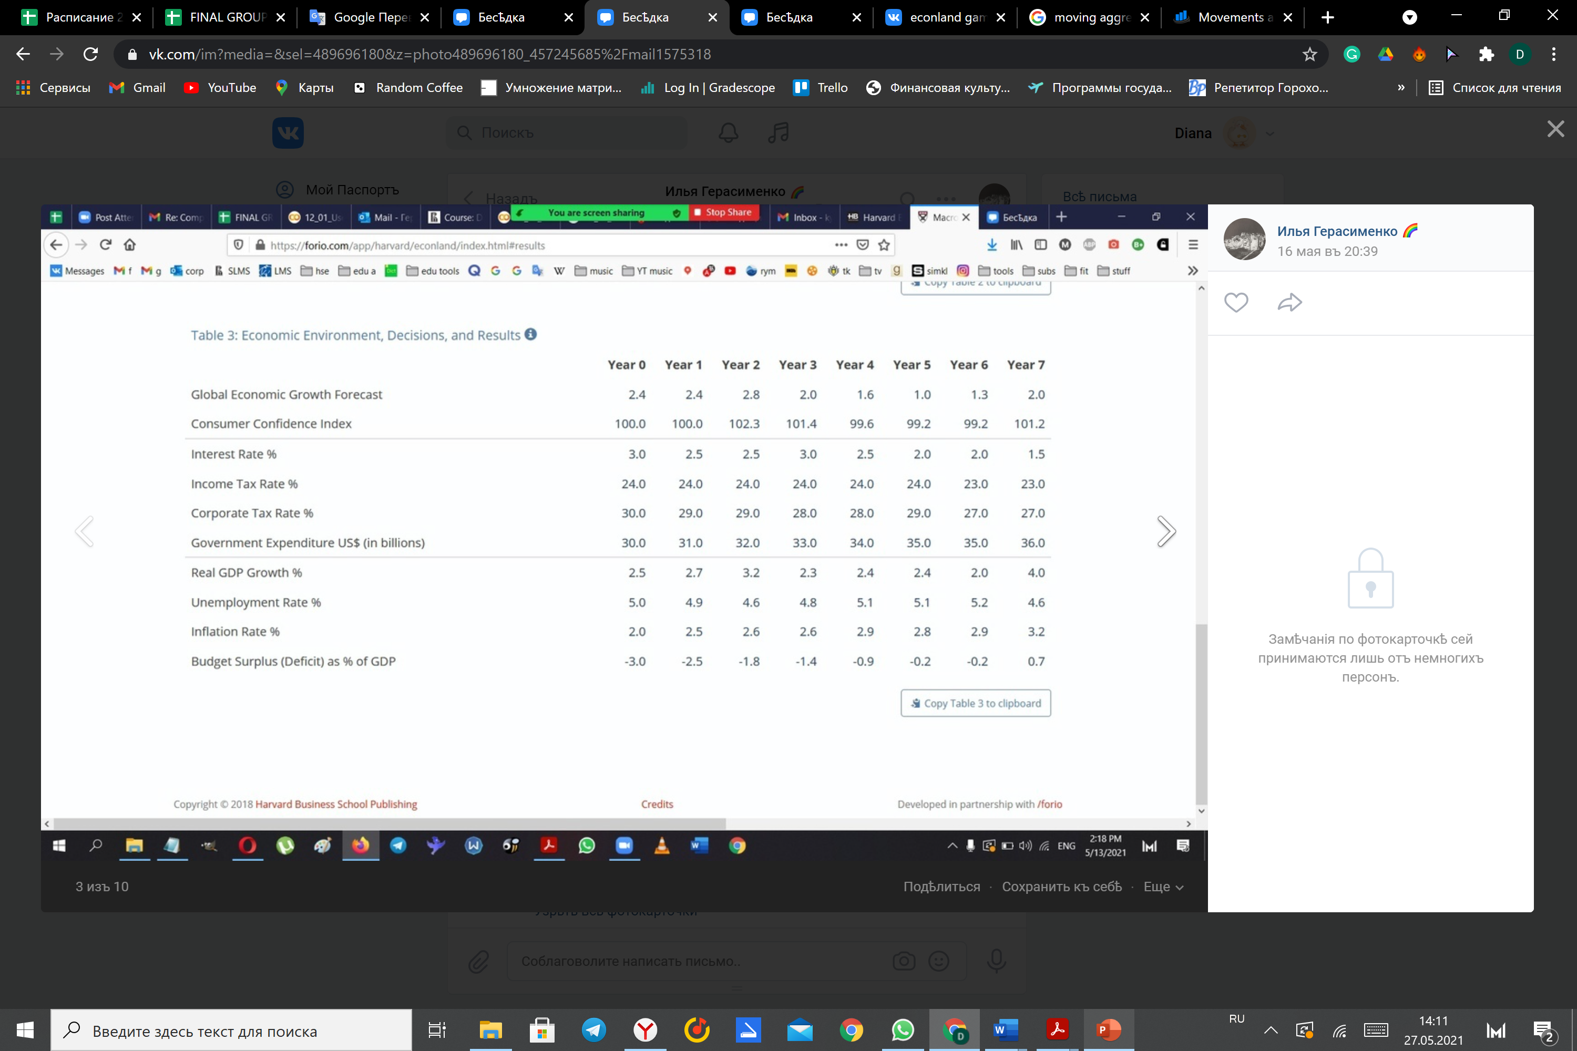

d
YEAR 2 - YEAR 4
.
In year two
increasing our government expenditure
In year three
reverting our change to the interest rate back to 3% due to concerns of growing inflation.
In year 4
putting our interest rate back to 2.5% to recover the GDP growth.
Result:
the unemployment also rose to 5.1%.
Inflation and budget surplus were still kept under control.
reduced the aggregate demand and the GDP growth

Slide 7





d
YEAR 3
.
P
LRAS
SRAS
In year 3 we also reverted our change to the interest rate back to 3% due to concerns of growing inflation.
We did manage not only to stop it from growing but decreased it a bit. However, that came at the expense of a significant decrease in the GDP growth.
AD1
AD2
Y
Yn

Slide 8
YEAR 5 - YEAR 7
In year 5
furthering lower our interest rate (to 2%)
increasing the corporate tax by 1% to slow down the decrease of our budget surplus.
Result: a slight increase in GDP growth.
In year 6
lowering both tax rates by 1 and 2%
keeping the government expenditures the same.
Result： our GDP growth decrease.
In year 7
lowering the interest rate further by 0.5%
beginning to increase expenditures.
Result:
doubled our GDP growth
reduced unemployment
raised the inflation above the threshold.

Slide 9


S
YEARS 1 - 3
P
Here we decided to lower interest rate from 3% to 2.5%, lowered corporate tax rate by 1% as we did in the first game. Moreover, we increased the government expenditure by 1 billion.
AD1 AD2

Slide 10




d
YEARS 4-5
.
P
LRAS
Here we have tried to get rid of inflation and unemployment increase. Therefore, we decided to lower interest rate as much as 1.5%, lower income tax rate by one percent.
AD1
AD2
Y

Slide 11


YEARS 6-7
P
Finally, in order to decrease inflation and unemployment at the same time trying to increase GDP, we lowered interest rate by 1%, increased tax rate by 1% as a symbolic increase in GDP, raised government expenditure by 1 billion.
AD1 AD2
AD
Y

Slide 12

Thank you for your attention

